Slide 1
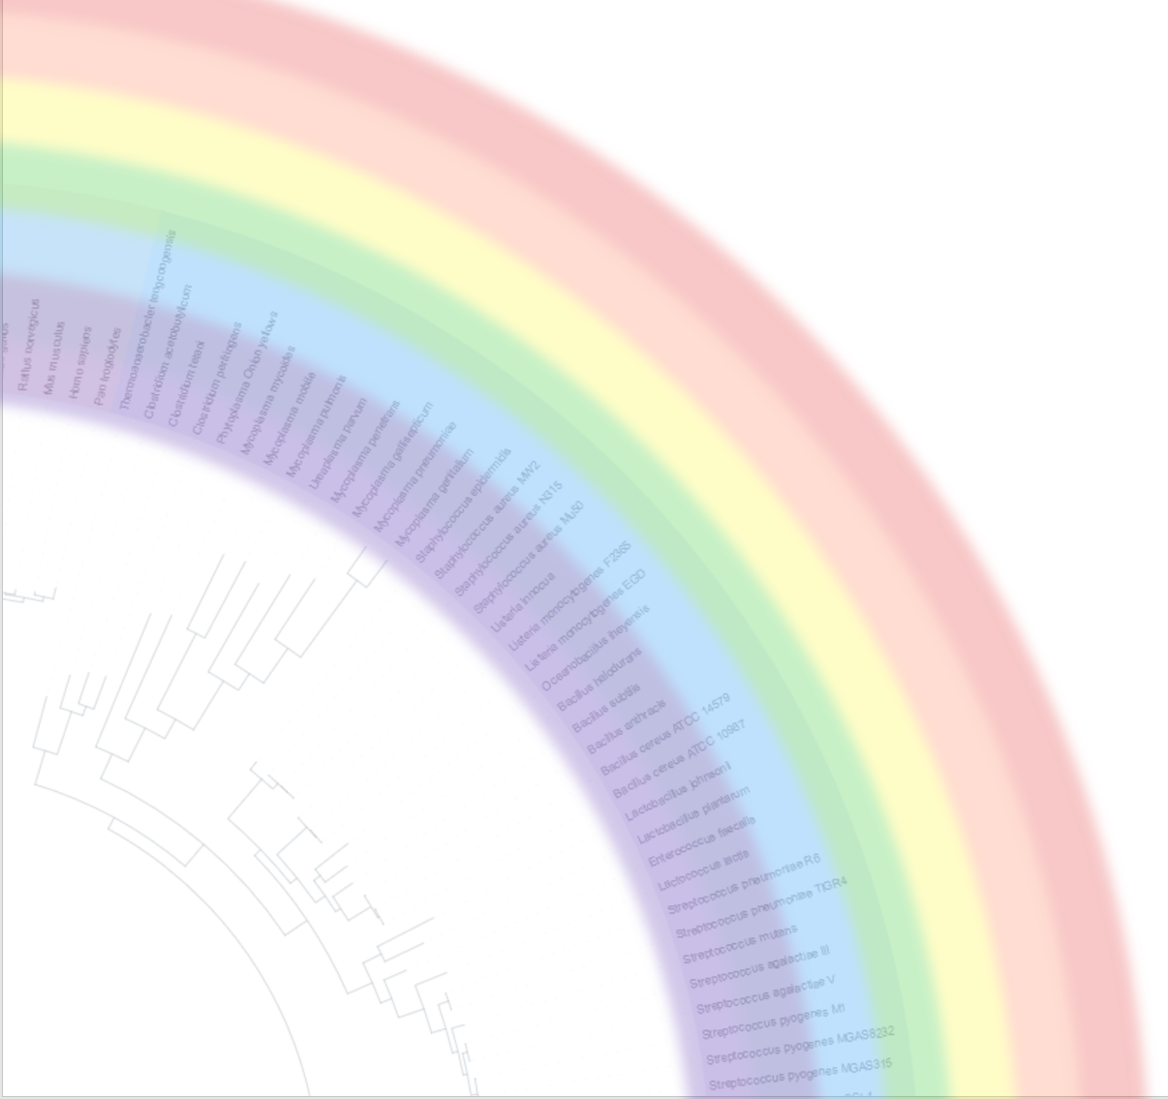
An Ontology for Host-Microbiome Interactions
Jihad Obeid, MD
BIOSTAT 2017

Slide 2




Multi-Institutional Collaboration
University of Michigan
Yongqun "Oliver" He, DVM, PhD
Haihe Wang, MD, PhD (visiting scholar from Harbin Medical University, China)
Yu Hong, MD, PhD (visiting scholar from Guizhou University Medical School, China)
Duke University
Anna Maria Masci, PhD
University of Pennsylvania
Jie Zheng, PhD
Medical University of South Carolina
Alexander V. Alekseyenko, PhD
Jihad S. Obeid, MD

Slide 3
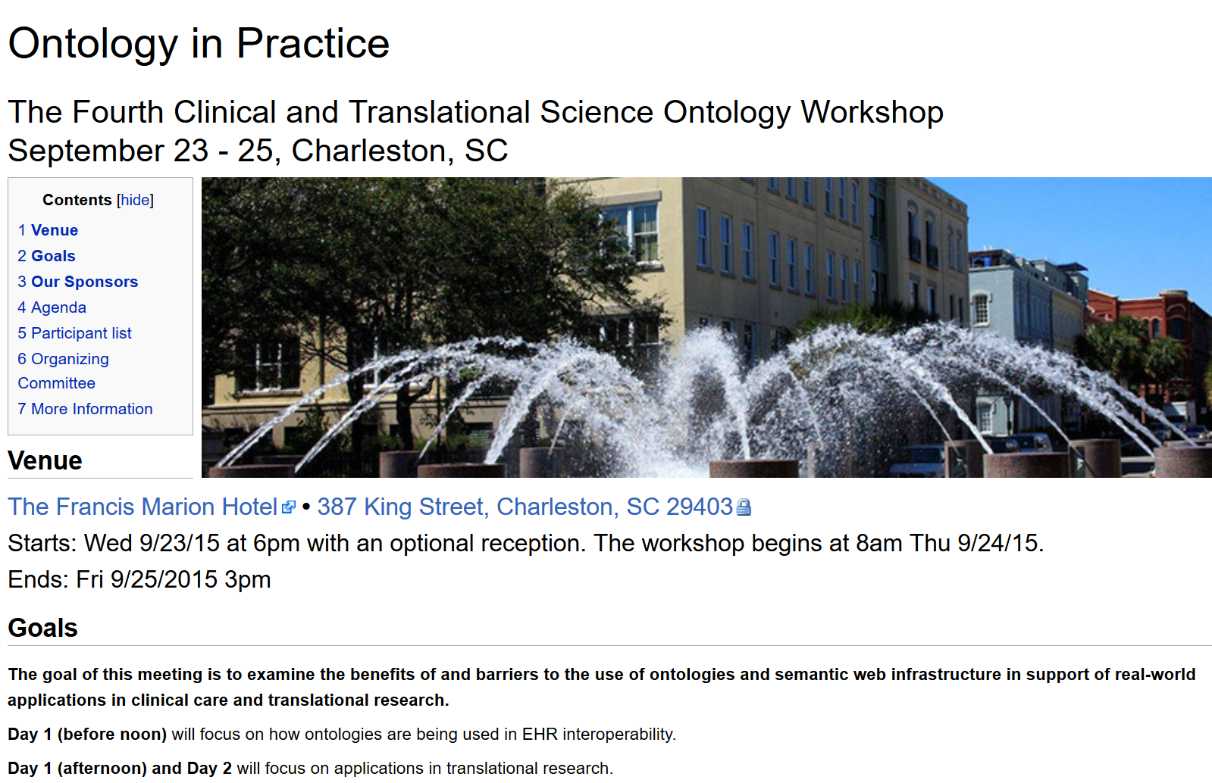
CTS Ontology Workshop 2015 http://ncorwiki.buffalo.edu/index.php/CTS_Ontology_Workshop_2015

Slide 4
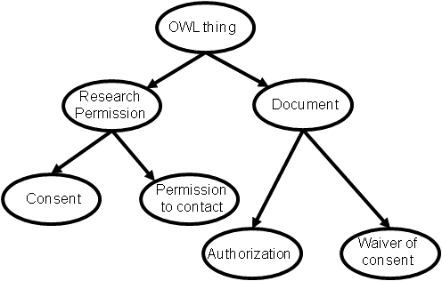
What is an Ontology (in Computer Science)
Definition: formal representation of the knowledge by a set of concepts within a domain and the relationships between them
Provides a schema for organizing data
Data annotation (e.g. NLP) and reusability
Underlying concept for semantic web (Web 3.0)
Allows semantic reasoning by computer systems (Computable)
Results in improved web searchers (e.g. Google, Microsoft, Facebook)
In biomedical research used for: classification of data, representation of standards, enhanced searches

Slide 5
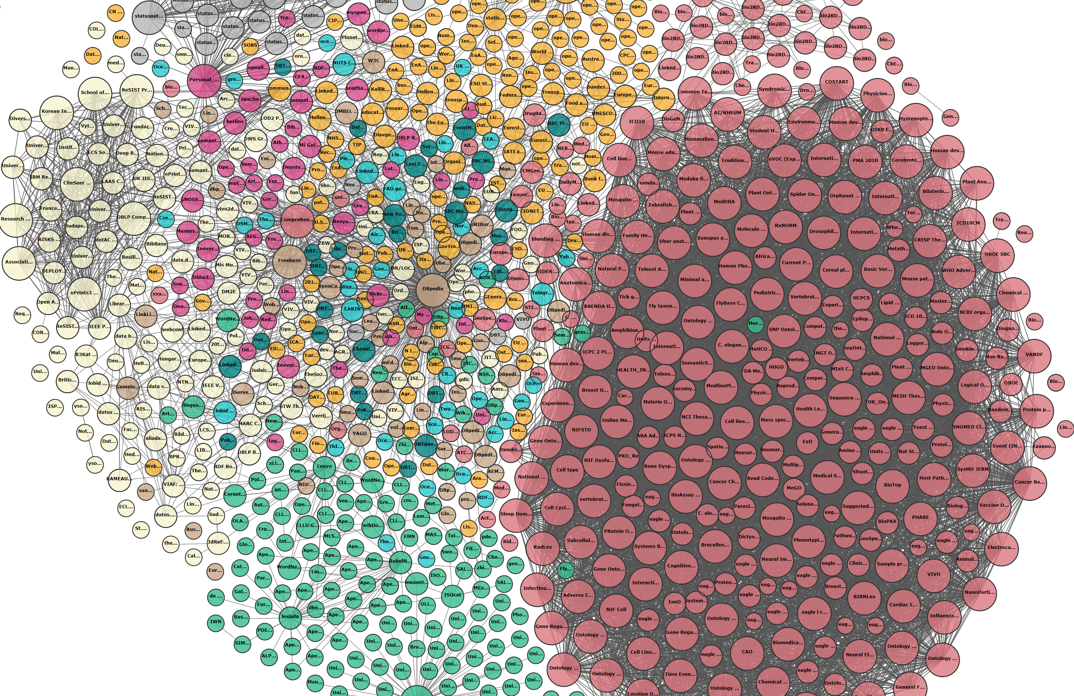
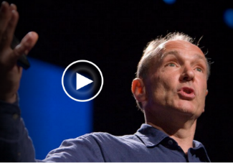
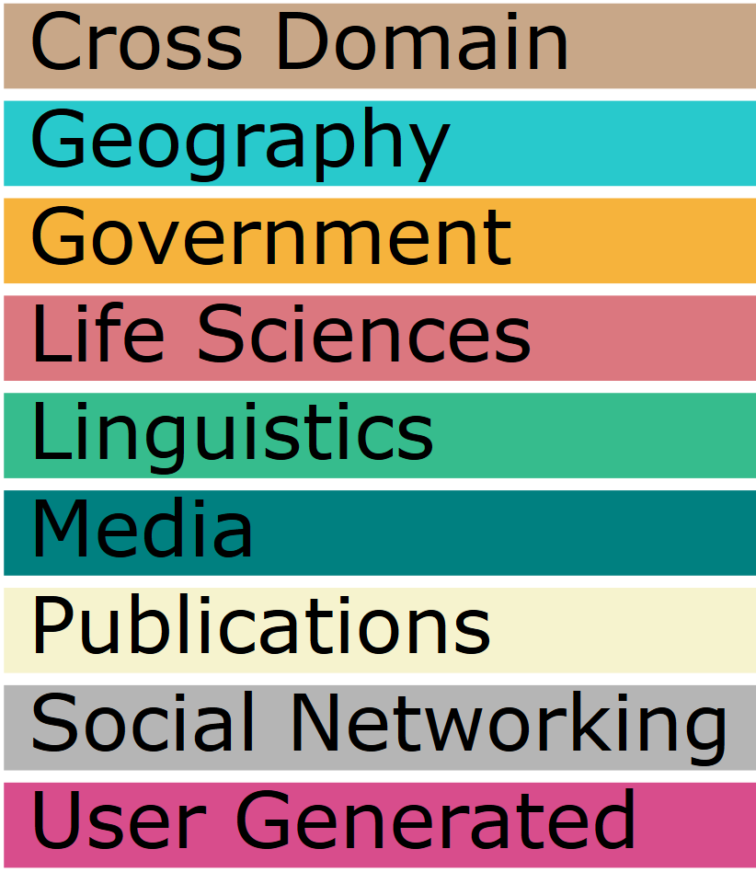
Linked Data – http://linkeddata.org/ → http://lod-cloud.net/ Video: Tim Berners-Lee's Linked Data talk from TED2009 (http://www.ted.com/talks/tim_berners_lee_on_the_next_web)
Source:
Linking Open Data cloud diagram 2017, by Andrejs Abele, John P. McCrae, Paul Buitelaar, Anja Jentzsch and Richard Cyganiak. http://lod-cloud.net/
Notes:
Term coined by inventor of the web!
Published ontologies are interlinked and are dominated by the life sciences.

Slide 6




Ontology Repositories for Life Sciences
Ontobee (developed by Oliver He’s lab)
http://www.ontobee.org/
Bioportal project (Stanford)
http://bioportal.bioontology.org/
Ontology Look up service
http://www.ebi.ac.uk/ols/index
Best practices for developing ontologies @ Open Biomedical Ontologies (OBO) foundry:
http://www.obofoundry.org/

Slide 7
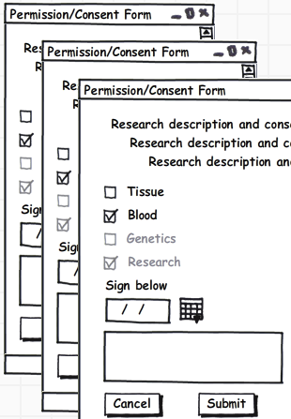
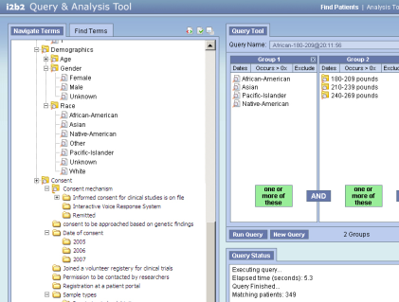
Role in Biomedical Research (examples)
Improved data collection using standard ontology
Annotation of research data (retrieval)
Ontology
Semantic reasoning: e.g.
find patients with an infiltrate on chest x-ray who had a positive blood culture
Query ontology
i2b2 Workbench

Slide 8
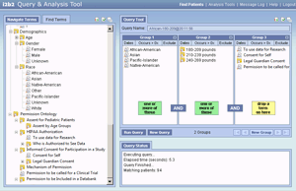
Biobank and Consent Ontologies (OBIB/ICO) Use Cases
Specimens from consented patients
TST123
TST123
TST123
Biobank system (TMX)
Combined clinical & biobank research queries
OBIB/ICO
OBIB
ICO
REDCap API
REDCap consent data
CDW
ETL
ETL
EHR source systems
i2b2 mart & client
Presented at: AMIA 2017 Joint Summits on Translational Science

Slide 9
Microbiome Related Ontologies
MicrO: Ontology of Prokaryotic Phenotypic and Metabolic Characters, published last year. (https://github.com/carrineblank/MicrO/)
MEOWL: Microbial Environments described using OWL, by Ramona L. Walls. (https://github.com/hurwitzlab/meowl)
OMP: Ontology for Microbial Phenotypes, Deborah A. Siegele, Ph.D., Texas A&M University. (https://microbialphenotypes.org)
Notes:
Refs:
MicrO: Blank CE, Cui H, Moore LR, Walls RL. 2016. MicrO: An Ontology of Phenotypic and Metabolic Characters, Assays, and Culture Media Found in Prokaryotic Taxonomic Descriptions, Journal of Biomedical Semantics 7:18. DOI:10.1186/s13326-016-0060-6. https://jbiomedsem.biomedcentral.com/articles/10.1186/s13326-016-0060-6.
Development hx: 2013-2016.
MEOWL: not published yet.
Development hx: 2015-Aug 2015?
OMP: https://microbialphenotypes.org
Development hx: 2011-2017.

Slide 10
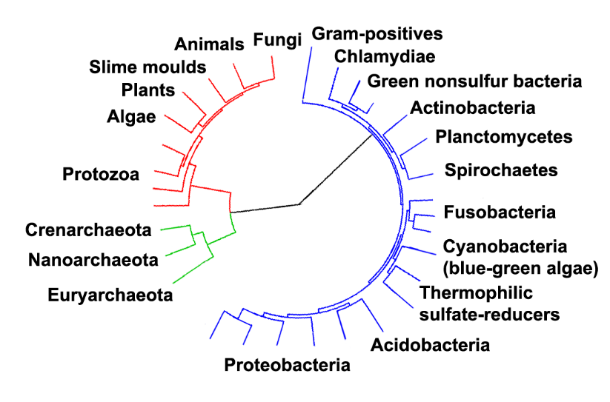
Microbial Taxonomy
Phylum-> Class-> Order -> Family -> Genus -> Species
e.g. NCBI Taxonomy Database: NCBITaxon ontology
Source: A highly resolved Tree Of Life, based on completely sequenced genomes. The image was generated using iTOL: Interactive Tree Of Life, an online phylogenetic tree viewer and Tree Of Life resource. (http://itol.embl.de/). Eukaryotes are colored red, archaea green and bacteria blue. (Image from https://en.wikipedia.org/wiki/Bacterial_taxonomy).

Slide 11
However…
…none covers interactions of a microbial population (microbiome) with a host organism hence …
the Ontology for Host-Microbiome Interactions (OHMI)

Slide 12
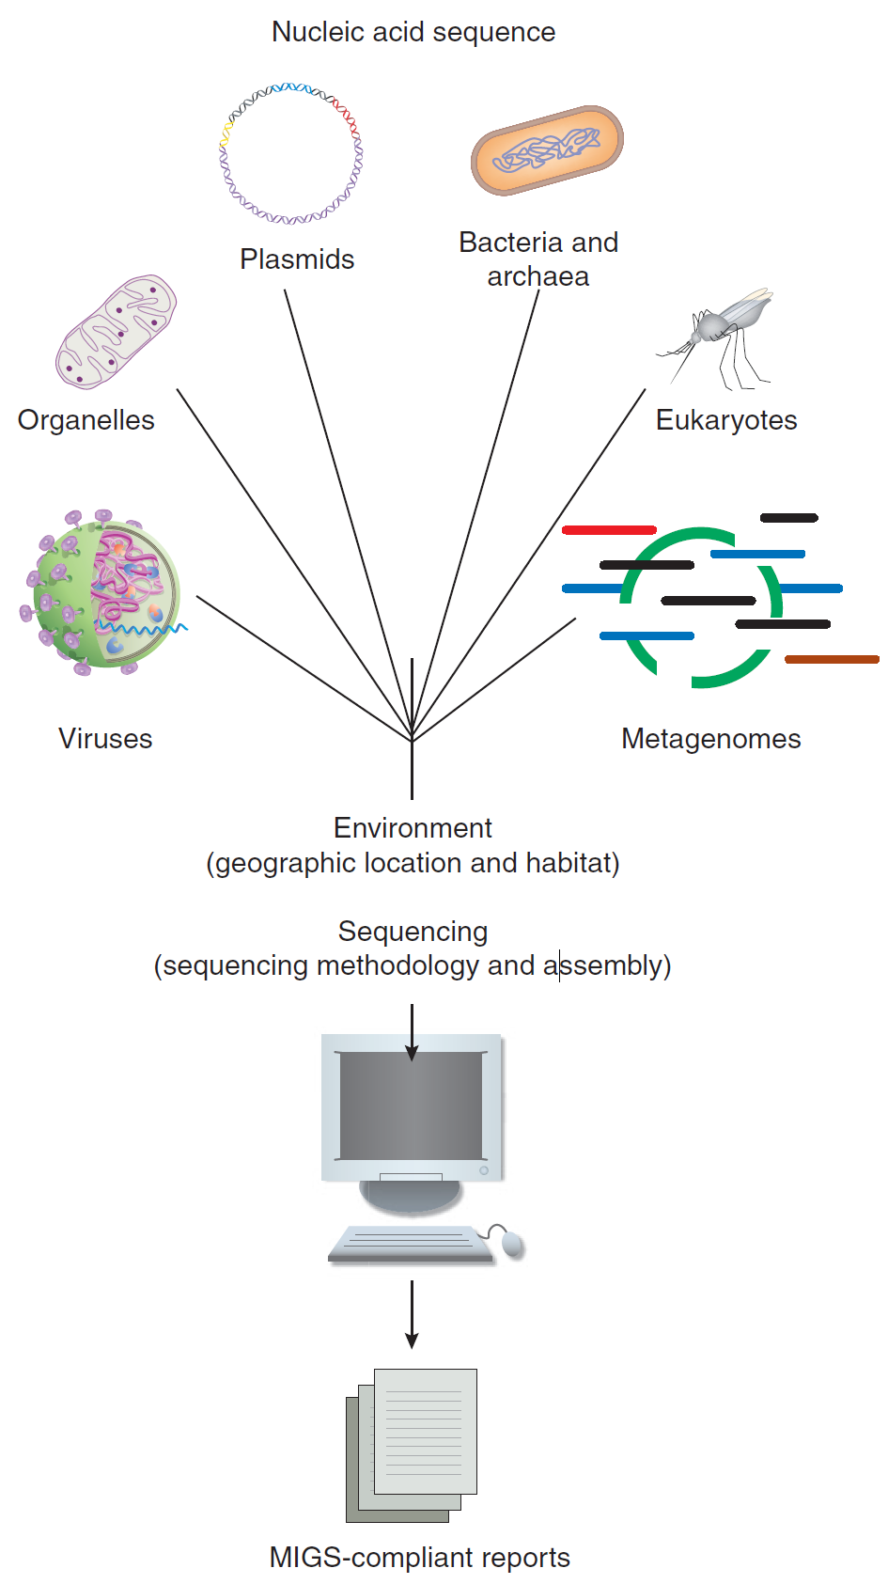
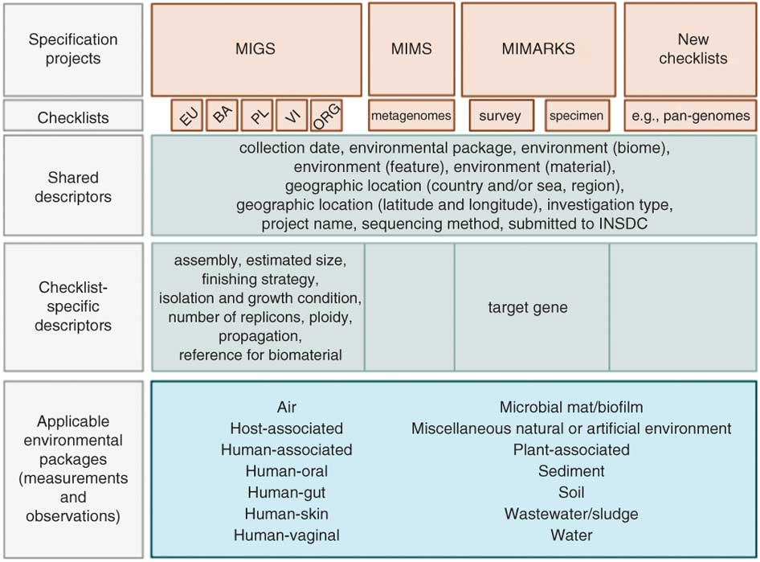
Reproducibility: MIGS → MIMARKS/MIxS → OHMI
Next: OHMI compliant experiment metadata
References:
Field, D. et al. The minimum information about a genome sequence (MIGS) specification. Nat. Biotechnol. 2008 May;26:541-547. PMID: 18464787.
Yilmaz P et al. Minimum information about a marker gene sequence (MIMARKS) and minimum information about any (x) sequence (MIxS) specifications. Nat Biotechnol. 2011 May;29:415-20. PMID: 21552244.
Notes:
The Genomic Standards Consortium (GSC) has previously introduced standards for describing genomic sequences— the “minimum information about a genome sequence” (MIGS)—and metagenomic sequences—the “minimum information about a metagenome sequence” (MIMS). These are extended by the introduction of “minimum information about a marker gene sequence” (MIMARKS). We also introduce a system for describing the environment from which a biological sample originates, as “environmental packages”. Finally, to establish a unified standard for describing sequence data and to provide a single point of entry for the scientific community to access and learn about GSC checklists, we introduce the minimum information about any (x) sequence (MIxS).
Quote from: http://gensc.org/projects/mixs-gsc-project/

Slide 13
OHMI Use Cases
Ankylosing spondylitis: Preliminary studies show link between arthritis and microbiome. Need to collect patient clinical data and microbiome data: 16S rRNA gene (specific to prokaryotes) – ultra-conserved region as well hypervariable regions (v1 through v9) which provide fingerprints of the different taxa. (YH)
RNAseq data: overarching use case for analyzing RNAseq for host gene expression and microbiome – microbiome relation to human health, e.g. COPD and smoking and impact of microbiome. (YH, AA)
Radiation induced oral mucositis (OM) development and treatment: A clinical trial in treatment of OM and the role that microbes in etiology. The microbiome in the oral cavity is shaped by the anatomical location and is highly dynamic in response to treatment. (AA)
IgA coated bacteria: compare IgA coated bacteria to everything else to see what is unique about the bacteria for the host. (AA)
Paraffin embedded colorectal cancers 16S rRNA genes. Host immune gene expression, and specific immune cell types in relation to microbiota and differences across races. (AA).

Slide 14
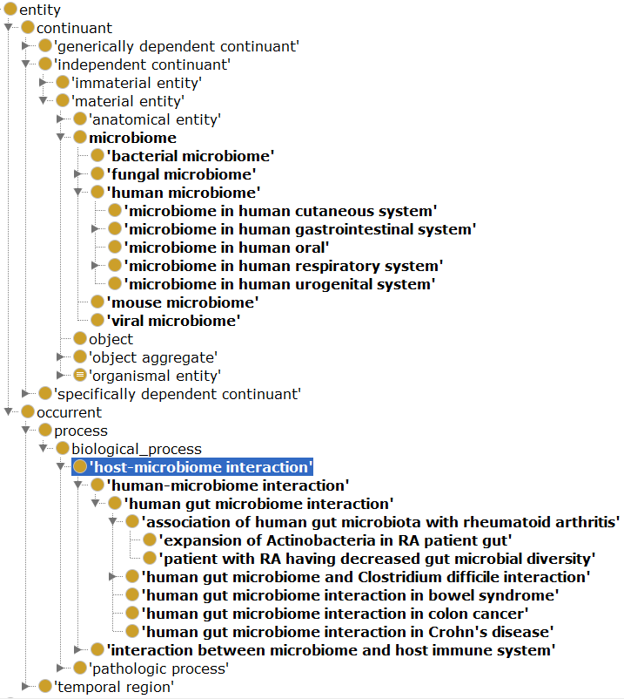
Progress
Based on the Basic Formal Ontology (BFO) principles.
Using Protégé (http://protege.stanford.edu/)
OHMI Statistics:
600 Classes
321 imported classes
279 new classes
86 Object Properties
94 Annotation Properties
Full stats at:
http://www.ontobee.org/ontostat/OHMI
Notes:
Many imported form NCBITaxon ontology.

Slide 15
Next Steps
Continued development of this new ontology
Expand the OHMI workgroup – membership is open for more participation from the community
Address use cases during further development
Update the ontology repositories with new versions of OHMI
Disseminate progress at conferences and via publication
Long-term goal: to use OHMI to standardize metadata from host-microbiome interaction studies

Slide 16

OHMI Distribution
GitHub: https://github.com/OHMI-ontology
: http://www.ontobee.org/ontology/ohmi
: http://bioportal.bioontology.org/ontologies/OHMI

Slide 17
Acknowledgements
Alexander V. Alekseyenko, PhD¹
Jie Zheng, PhD²
Anna Maria Masci, PhD³
Yongqun "Oliver" He, DVM, PhD⁴
Haihe Wang, MD, PhD⁵
Yu Hong, MD, PhD⁶
¹Medical University of South Carolina, ²University of Pennsylvania, ³Duke University, ⁴University of Michigan, ⁵Harbin Medical University, China, ⁶Guizhou University Medical School, China

